Slide 1
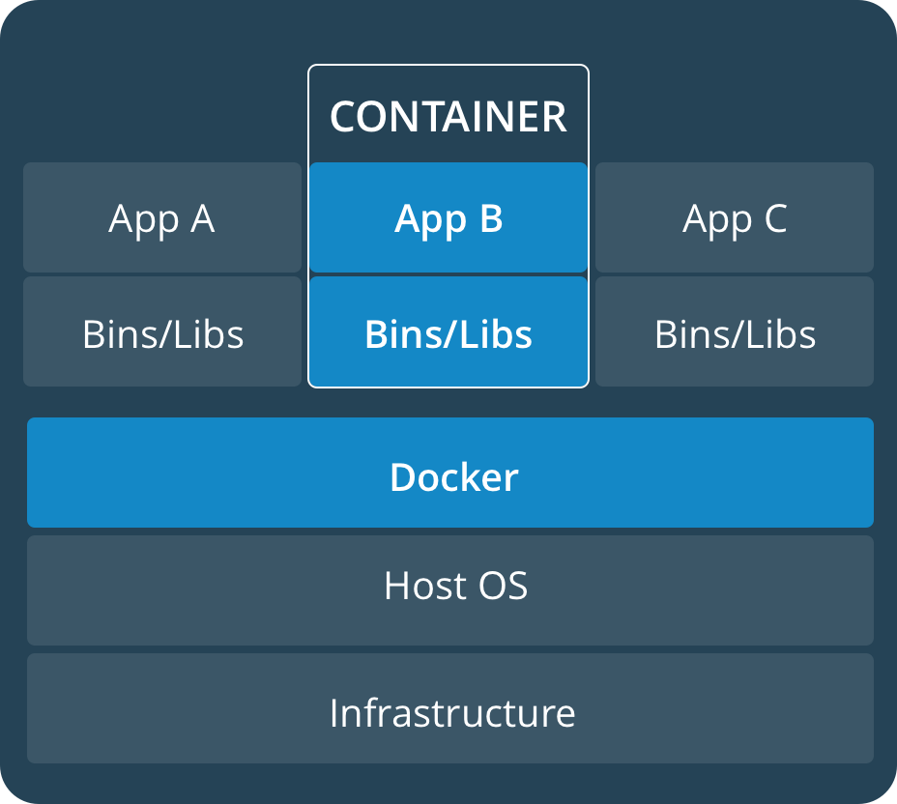

Real-time containerized applications Project phases
Determine system configuration, OS, RT-patch and engine
Evaluate latencies with different configurations in different settings: Bare metal, virtualized with direct hardware access (C5), virtualized standard instance
Develop a monitoring Framework, Benchmark
Setup a static schedule for a set of RT-applications to run in containers distributed on the available vCPUs
Develop a small specialized uni-kernel for the containers (depends on Docker support)
Elaborate dynamic scheduling algorithms for the same purpose and implement them in an orchestration service that runs in a separate container and manages the running applications

Slide 2
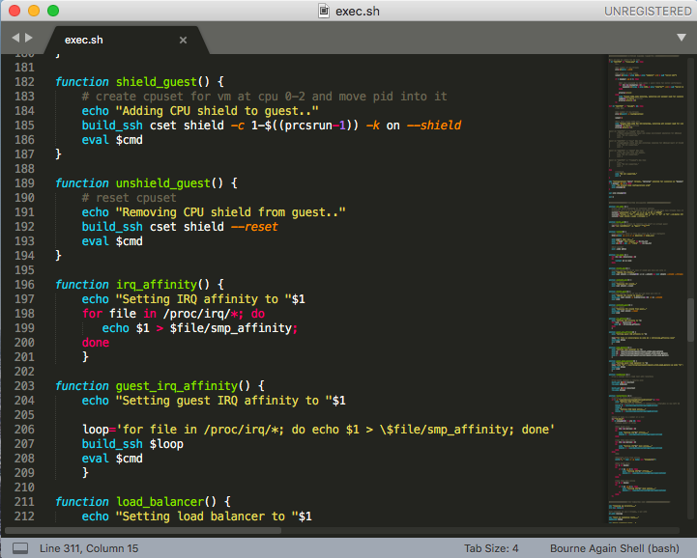
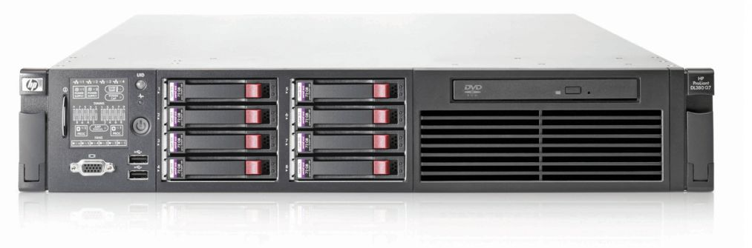
Performed steps
Identification of configuration and candidate guest OSs, evaluation of kernel patch variants
Basic tests with container Engines and RT run configuration
Basic latency tests finished, used hardware, i7 2Core 4 threads Skylake 16Gb RAM on Ubuntu 16.04 LTS host
A test script has been created to automatize the test execution
Recreated images with newer OS versions and patches for performance comparison and tests (Ubuntu 18.04 LTS)
Setup a new bare metal server, 8 Core XEON with two NUMA nodes and 24Gb RAM on Ubuntu server 18.04

Slide 3
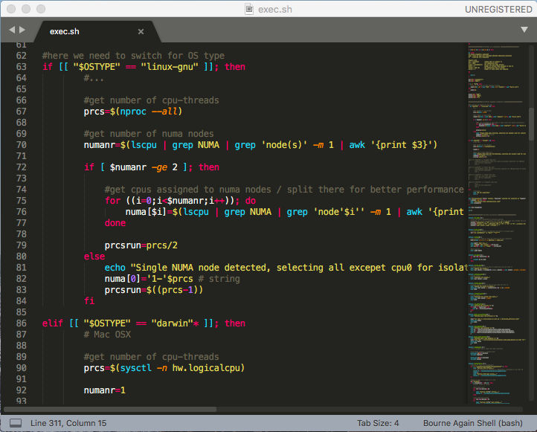
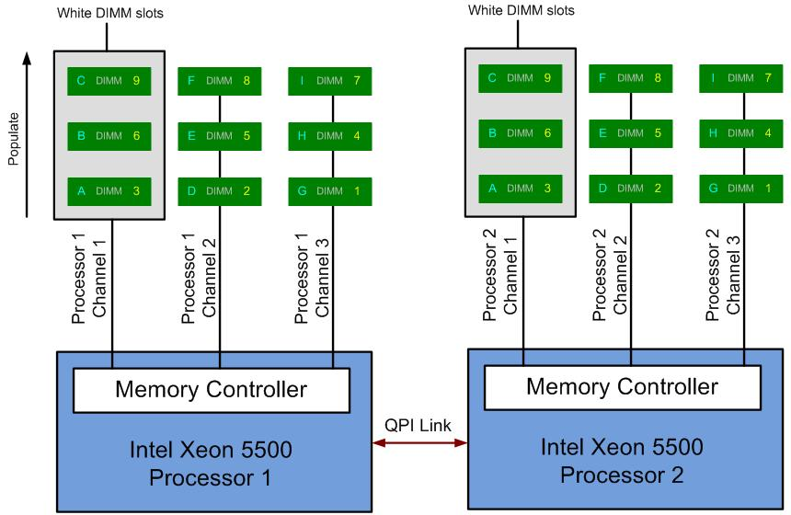
Progress of VM tests (now)
The following weeks are set to repeat and automatize tests on the new hardware and with various configurations
Tests to be repeated on new hardware, in particular considering cache banks and NUMA nodes
Conclusion of paper 1, publication of results evaluation RT containers settings and context, SEIP
Test execution script to be extended to automatically detect hardware
Configuration of KVM instances based on the same virtual machines, in particular tests with vCPU to pCPU pinning in order to emulate C5 behavior

Slide 4

Future steps
Replication of tests in the AWS cloud, C5 and generic instances
Extension of test script with parameters and selective execution
Comparison of results and evaluation of possibilities
Conclusion of paper 2, publication of results latency evaluation, RTASS
Next Group: Ideation of a static offline schedule for a set of RT tasks per CPU
Next Group: Configuration of such schedule using dummy counting instances (rt-app) for each container, pus test run

